Slide 1

Project MUSIC STORE DATABASE

Slide 2
Group Introduction :
Shivam Sheth
Shubham Mevada
Premal Joshi
Nirav Paneliya

Slide 3
ER – Model :

Slide 4
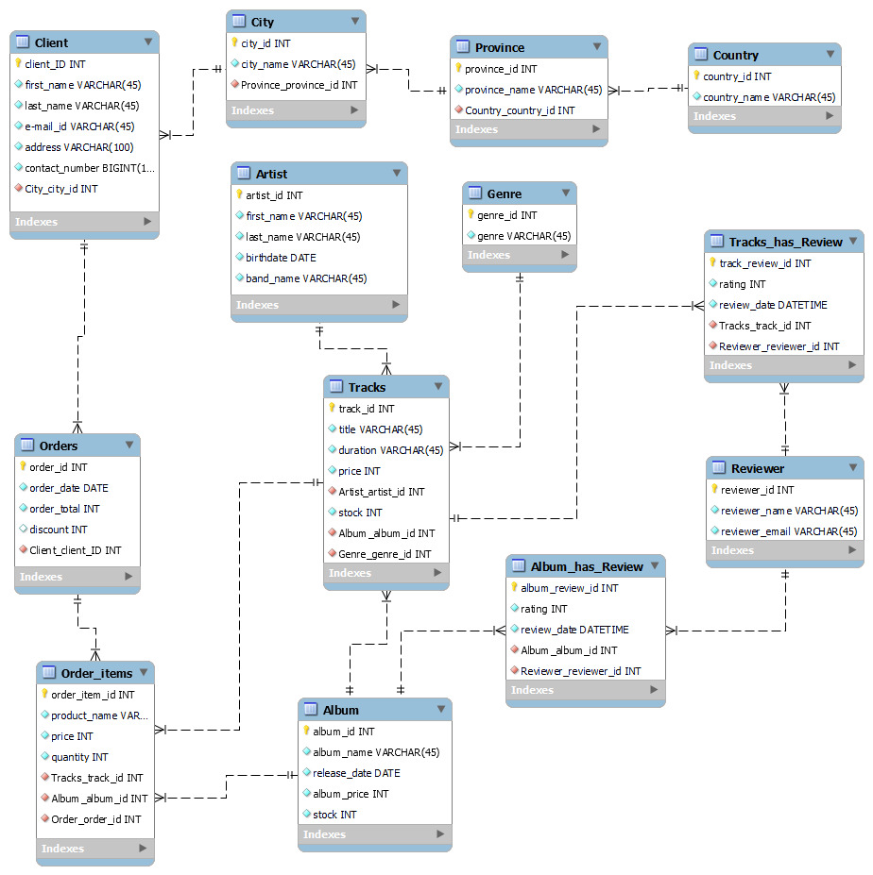

Slide 5
Introduction to Project :
-> This is a “Music Store Database”.
-> Customer can view different types of music albums of different artist and different genre.
-> Customer can also order the same.

Slide 6
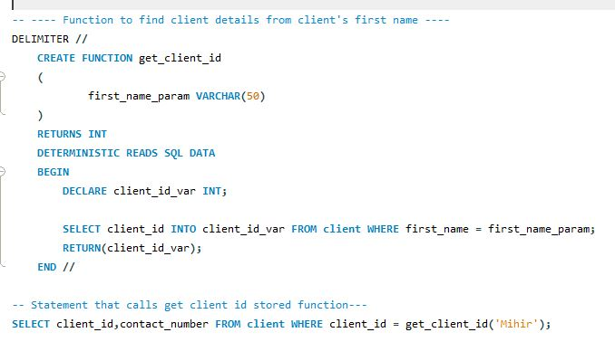
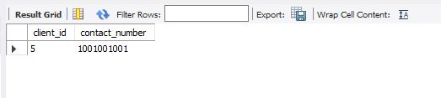
Functions : -> For this project we have created 3 functions : 1. To get the client id by using client’s first name.( Function name : get_client_id)

Slide 7
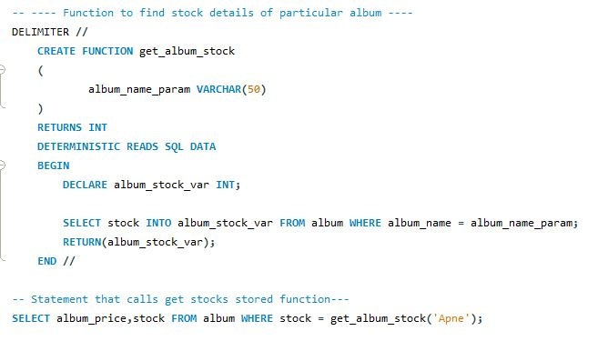
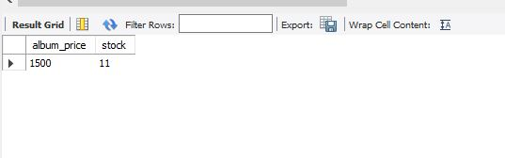
2. To get the stock details from particular album name.(Function name :get_album_stock)

Slide 8
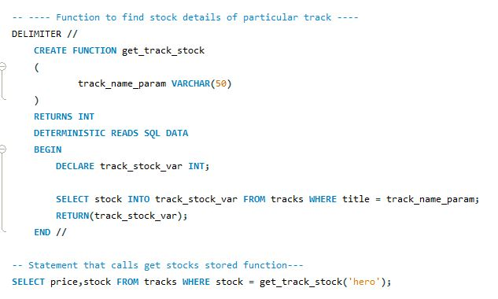
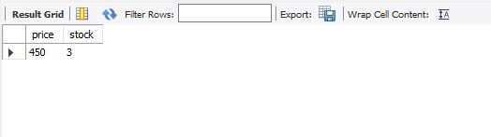
3. To get the stock details from particular track name. (Function name :get_track_stock)

Slide 9
Client Table :
-> Client table will consist of all the data of the customer.
-> It has the most appropriate field required for database.
-> To maintain data redundancy and integrity we have created separate tables for city, province, country.

Slide 10
Artist Table :
-> The artist table consists of all the details of each singer.
-> The band name has been added so that it could be easier to search the artist based on his group.
-> The artist table has one-to-many relation with the tracks table.

Slide 11
Tracks :
-> The tracks table consist of each individual track that a singer has composed.
-> the various data field included I the track table are the title ,priced,uration and stocks.
-> the track table is unique in its own way as it has relationship with the artist album as well as the genre table.

Slide 12
Album :
-> Album table consist the record of all the tracks included in a single album.
-> As each album varies in price there is a field named album price.
-> The release date helps in searching or sorting the latest albums for the user.

Slide 13
Order and Order-items :
-> The order table contains the data of all the items that a customer has purchased.
-> It is always necessary to know the date when the order has been placed.
-> There has been a discount field which maybe applicable to few users.

Slide 14
Continue……
-> The order-total consist of the final price of the order.
-> The order-items table consist of the individual quantity of each order.
-> The name of the product ordered can be easily accessed using the order-items table.

Slide 15
Genre :
-> the genre table contains all a single data field that is the genre name.
-> we have included almost every possible type of genre in our database.

Slide 16
Reviewer :
-> one of the best way to find if a database is successful or not is by knowing the satisfaction of the user.
-> hence we have included the reviewer table which helps in maintaining the rating as well as the contact information email of the reviewer.
-> the reviewer can give review to both the album and the tracks.

Slide 17
Thank You.

